Slide 1
Flight Schedule Pro Replacement
May 31, 2017
By: David Irvine

Slide 2
Guide for Pilots
Boeing Employees’ Flying Club – STL
Reserve, Dispatch, and Check-in Flights • Record Squawks • View Contact Info
View Bills/Account Statements

Slide 3
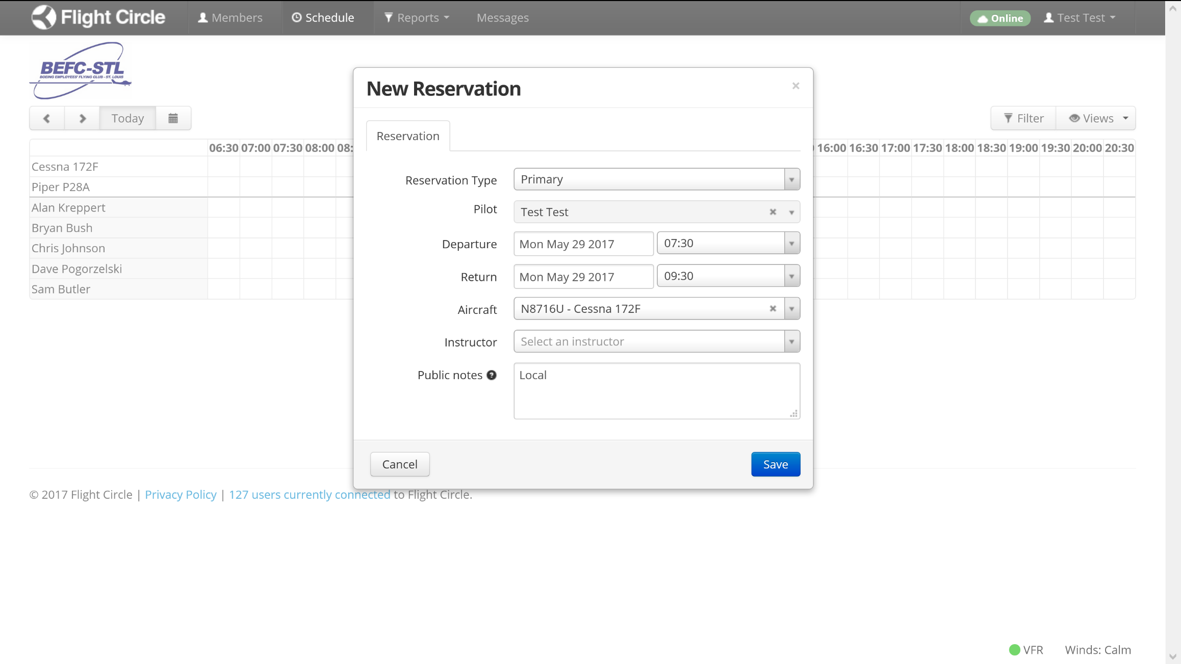
Make a reservation
Enter Flight Route

Slide 4
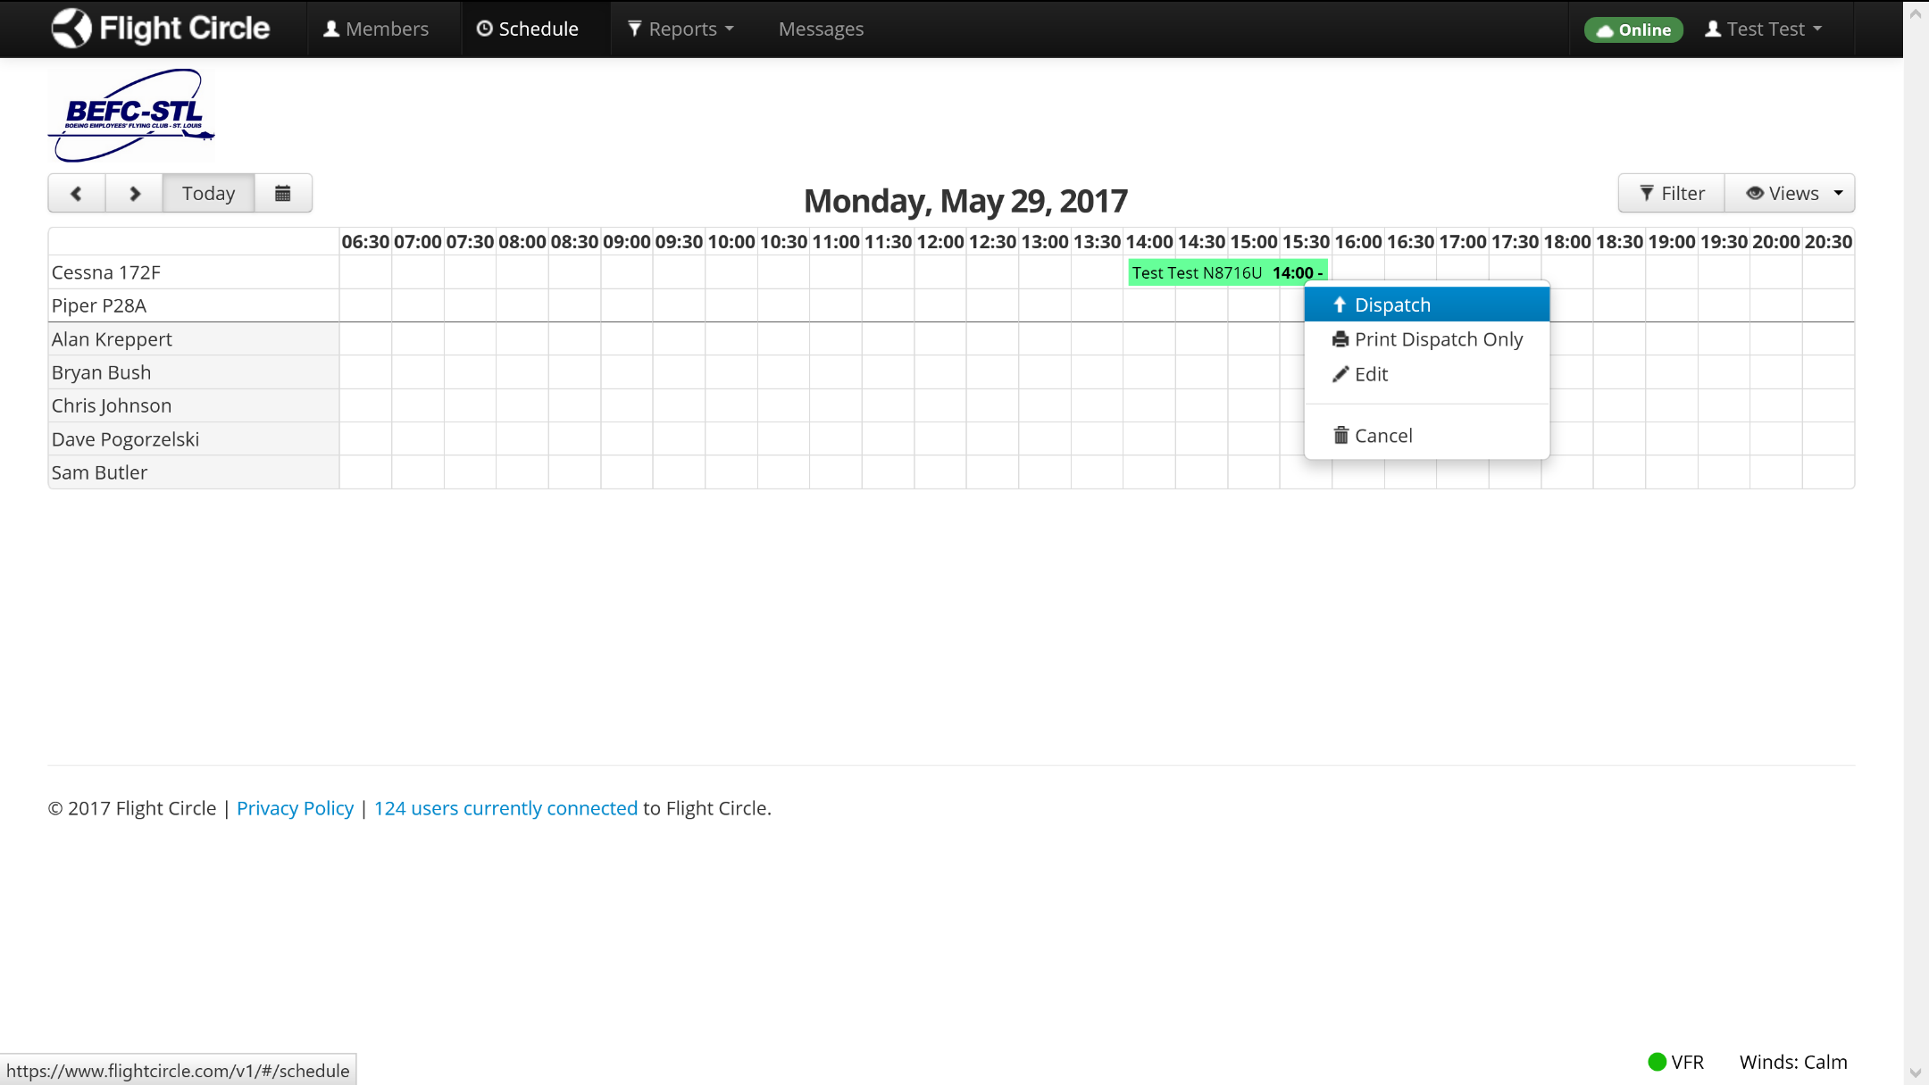
Dispatch a flight – Step 1

Slide 5
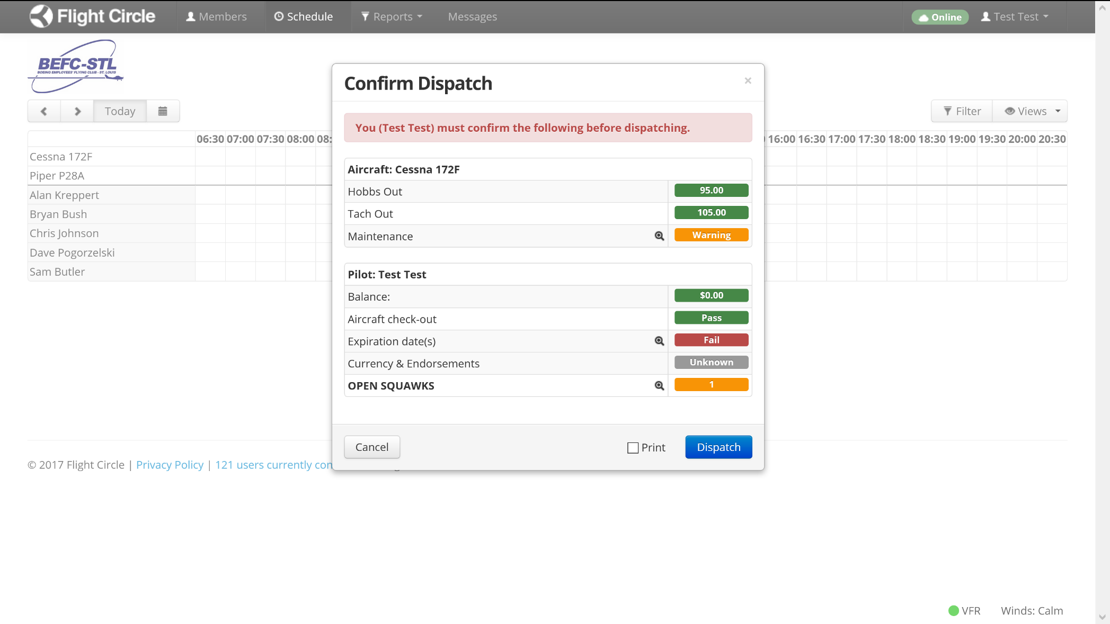
Dispatch a flight – Step 2
Verify Tach Out Time is accurate - Call a board member if it isn’t.
Also view Open Squawks by clicking the magnifying glass.

Slide 6
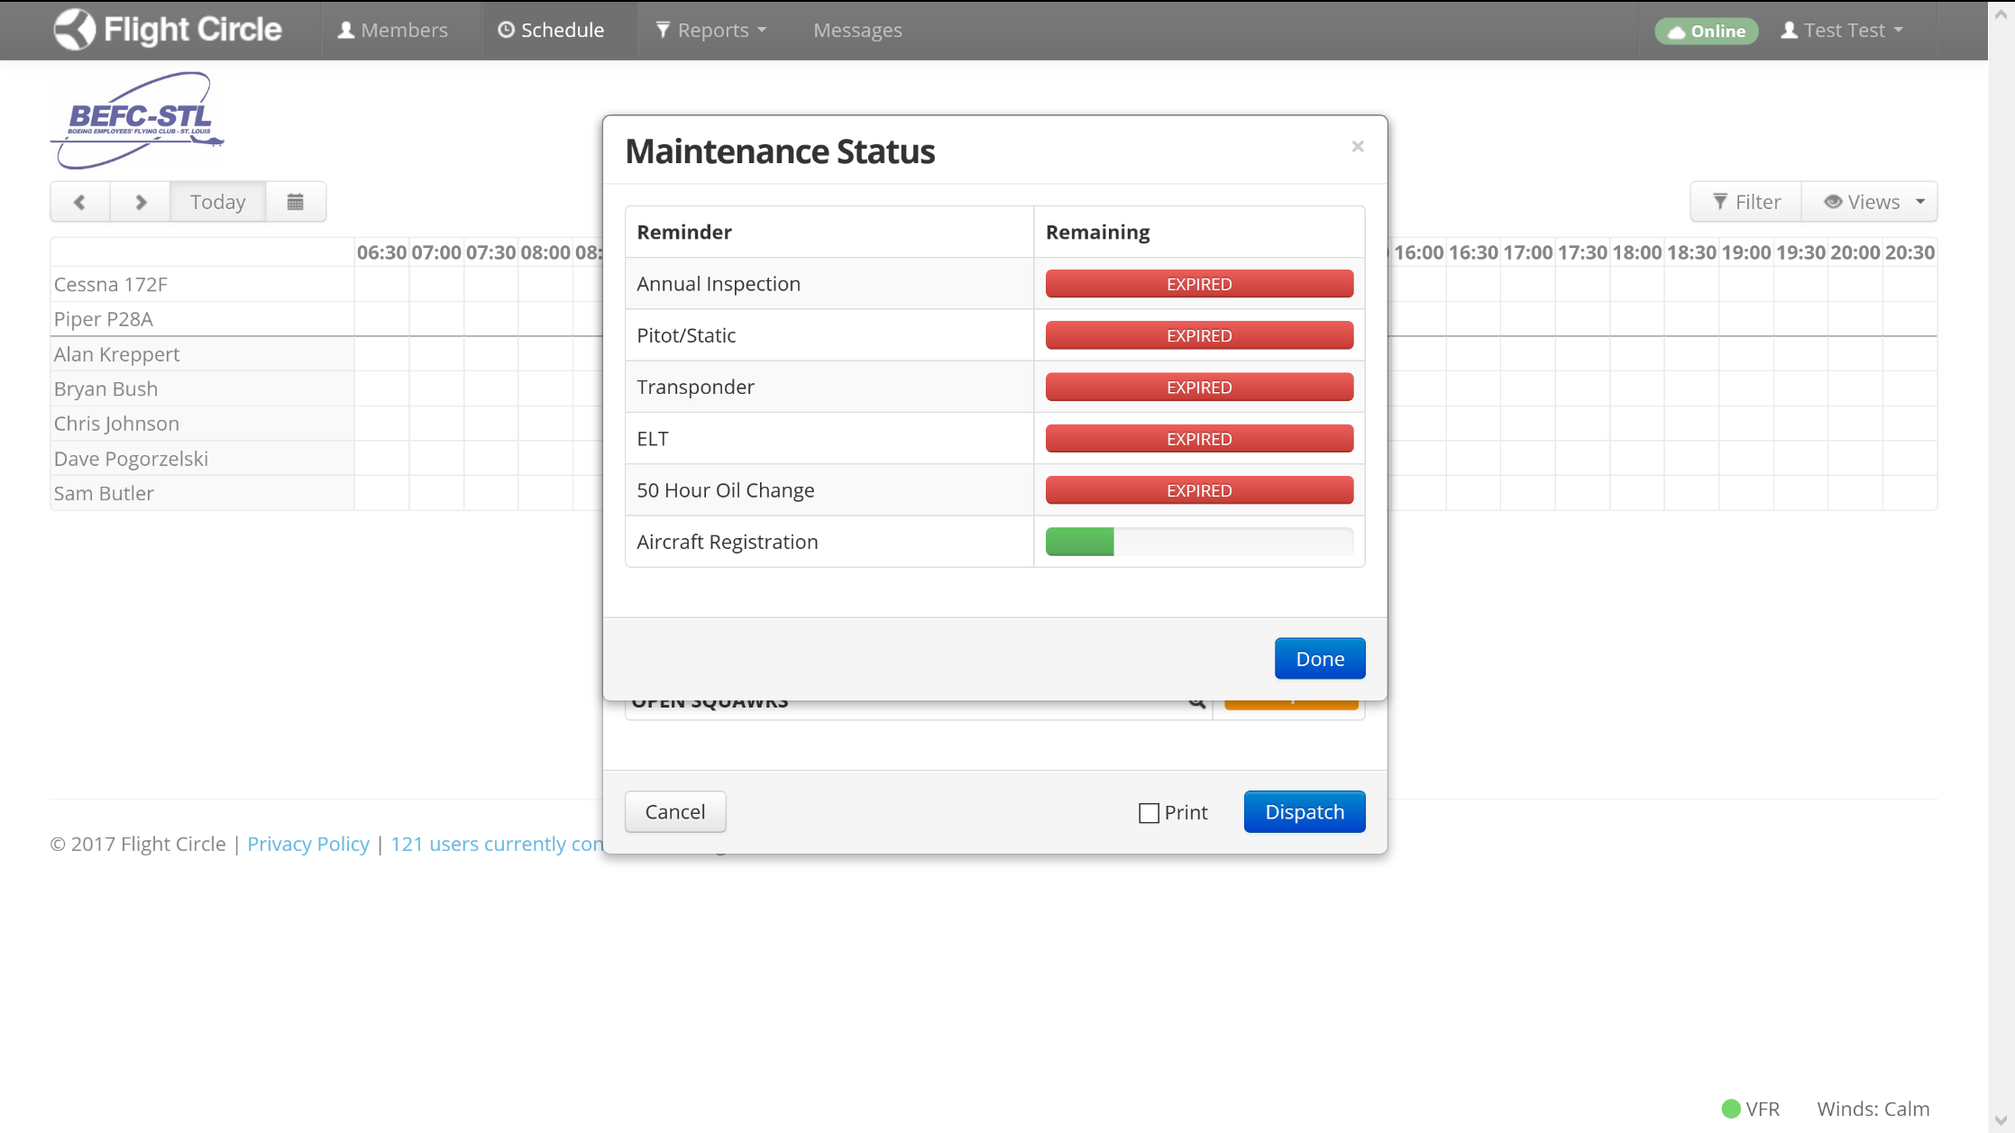
Dispatch a flight – Step 2 Cont’d
Verify Aircraft Status

Slide 7
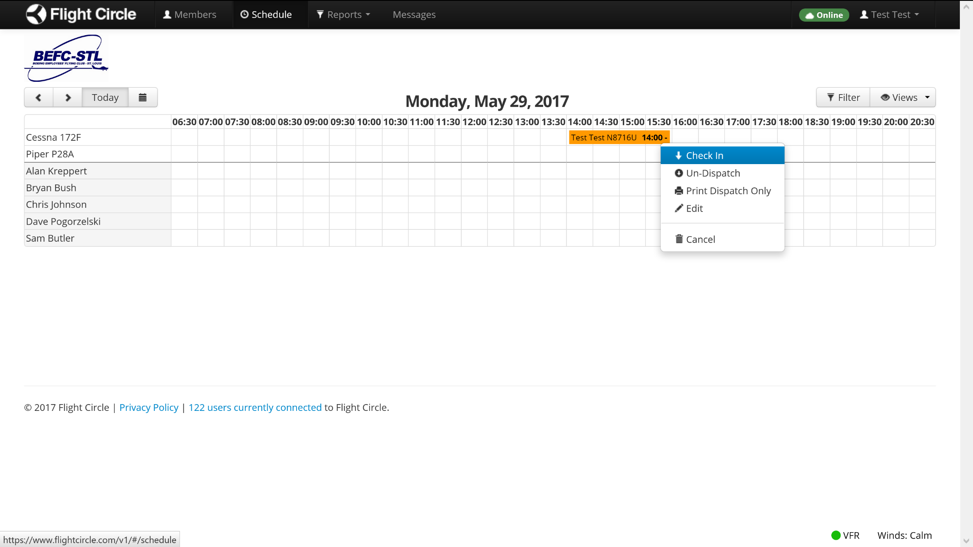
Check-in a flight – Step 1

Slide 8
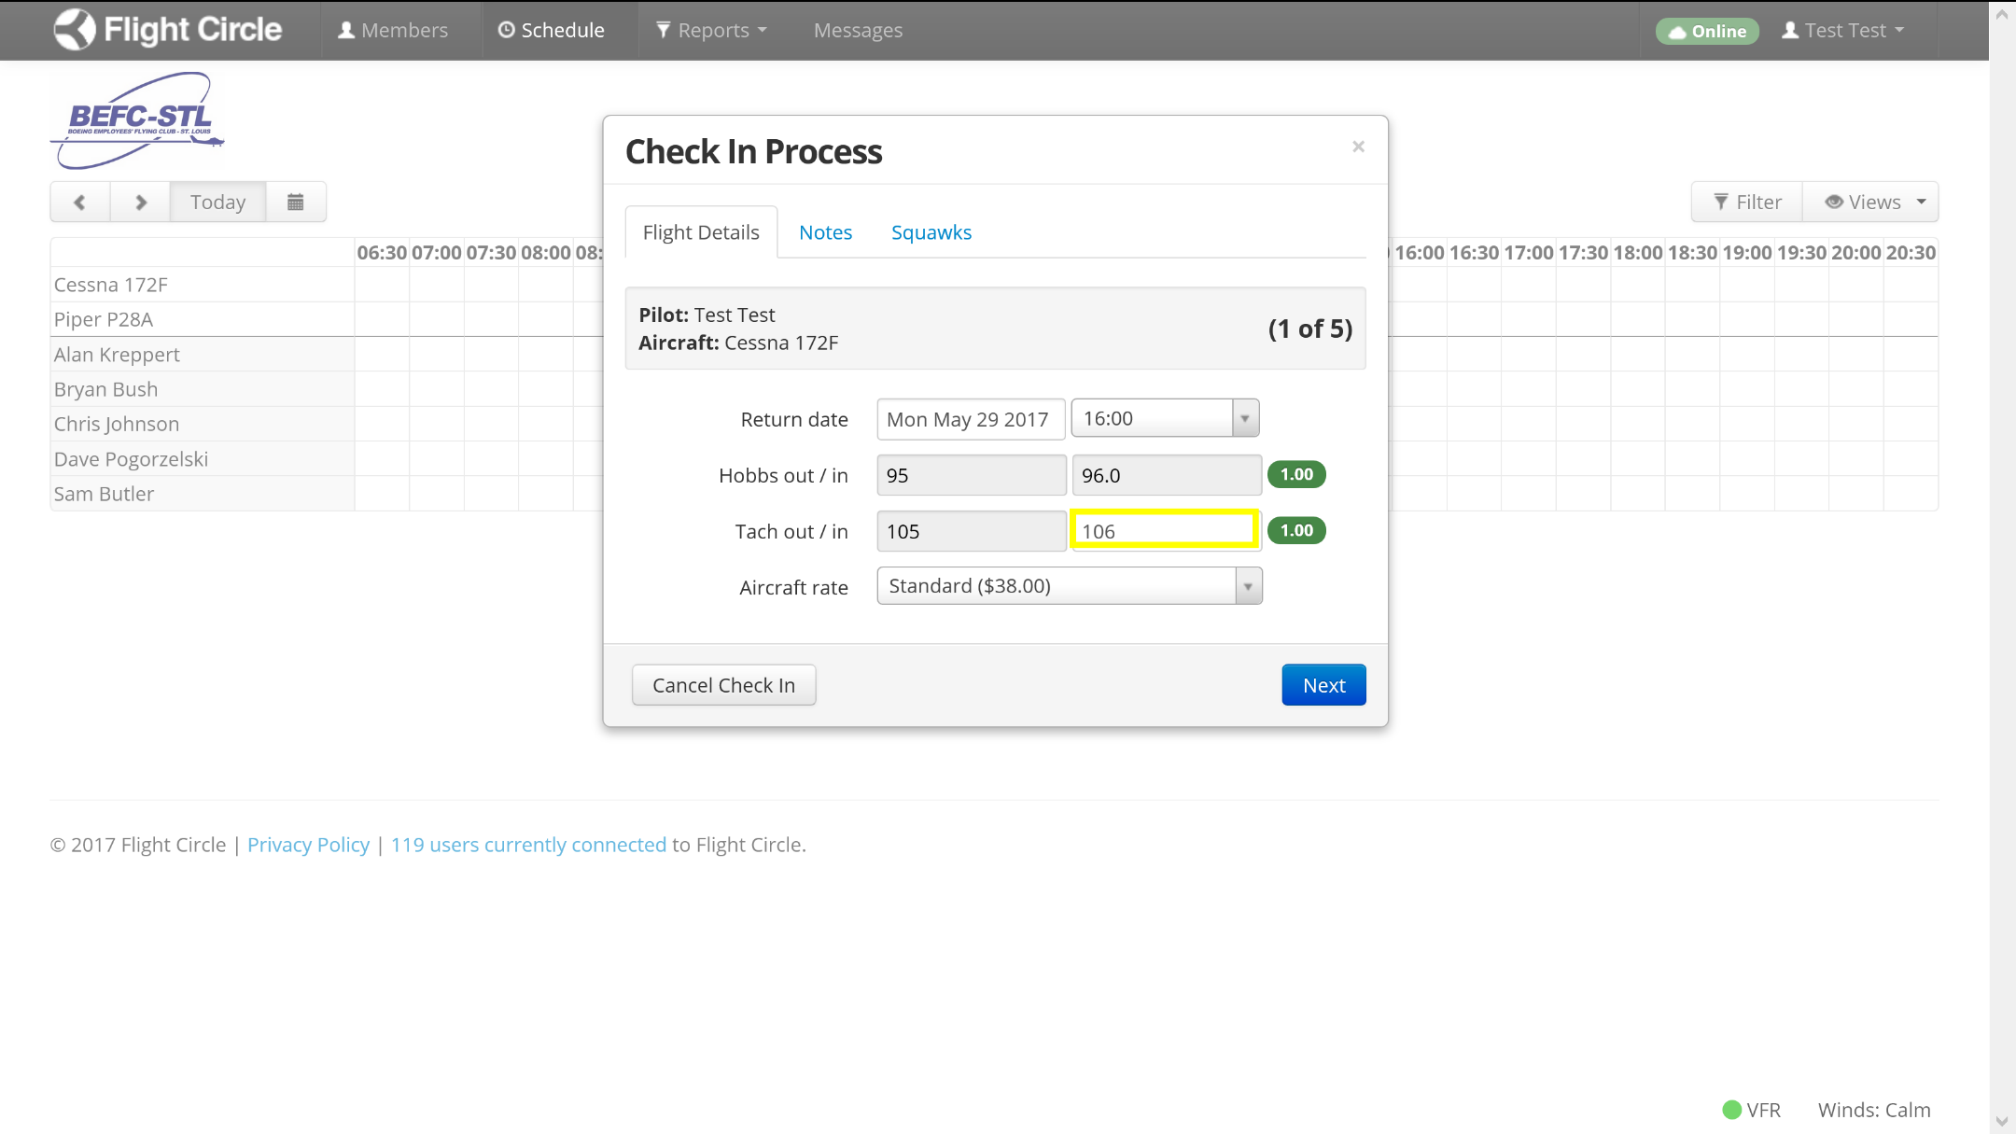
Check-in a flight – Step 2
Record Tach Time

Slide 9
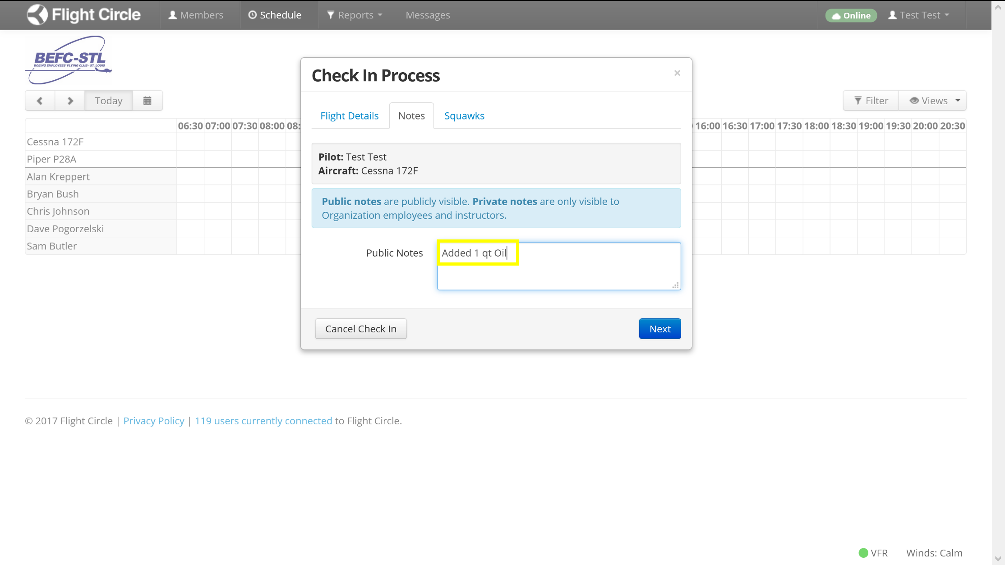
Check-in a flight – Step 3 (Record Oil Added)
Record Oil Added During Check-in

Slide 10
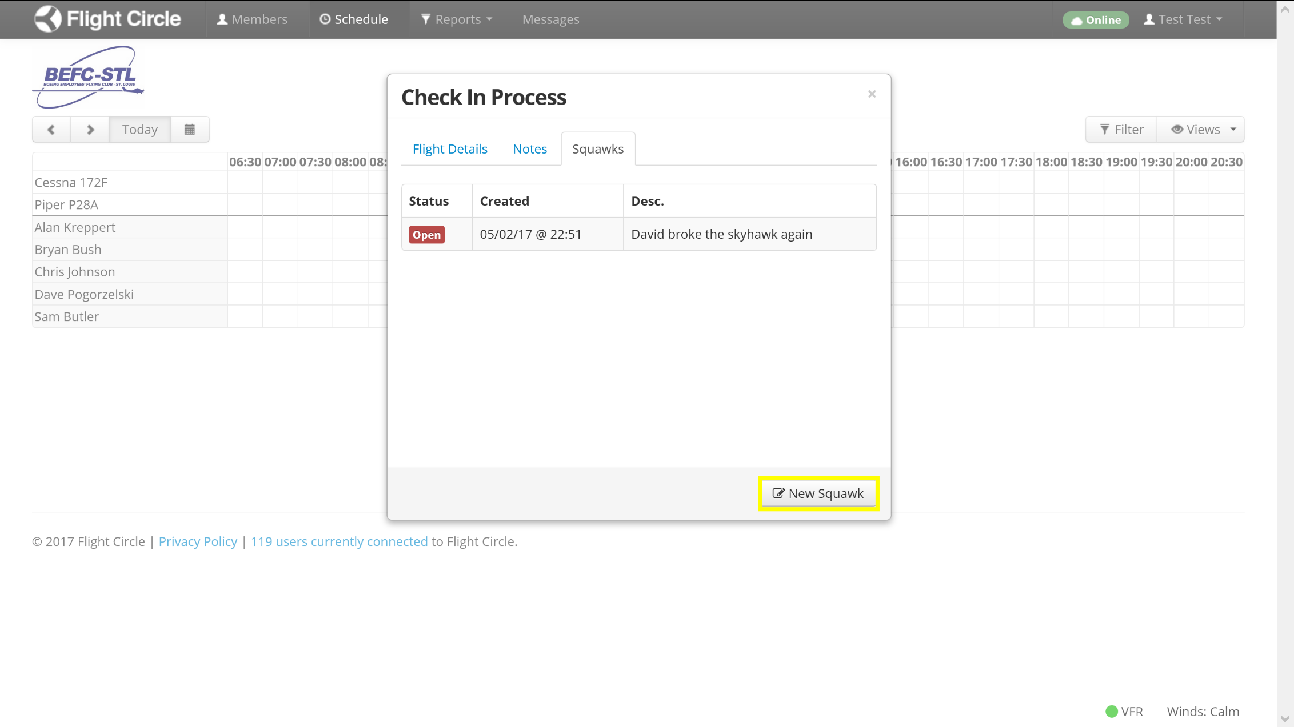
Check-in a flight – Step 4 (Add new squawks)

Slide 11
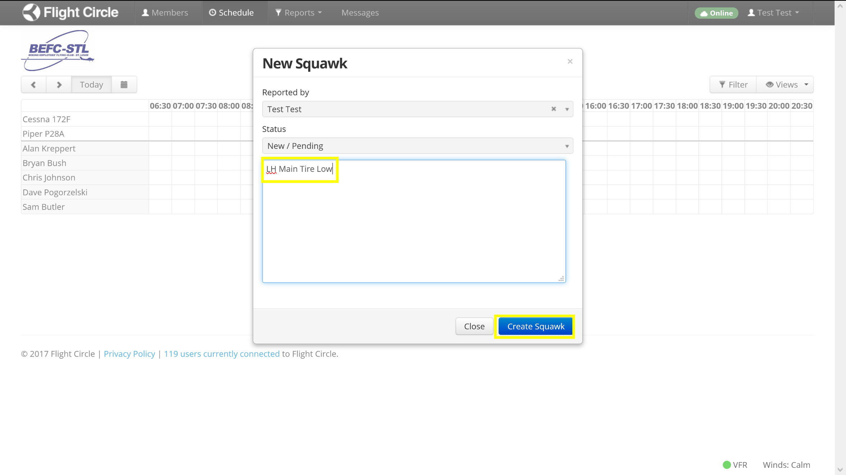
Check-in a flight – Step 4 Cont’d

Slide 12
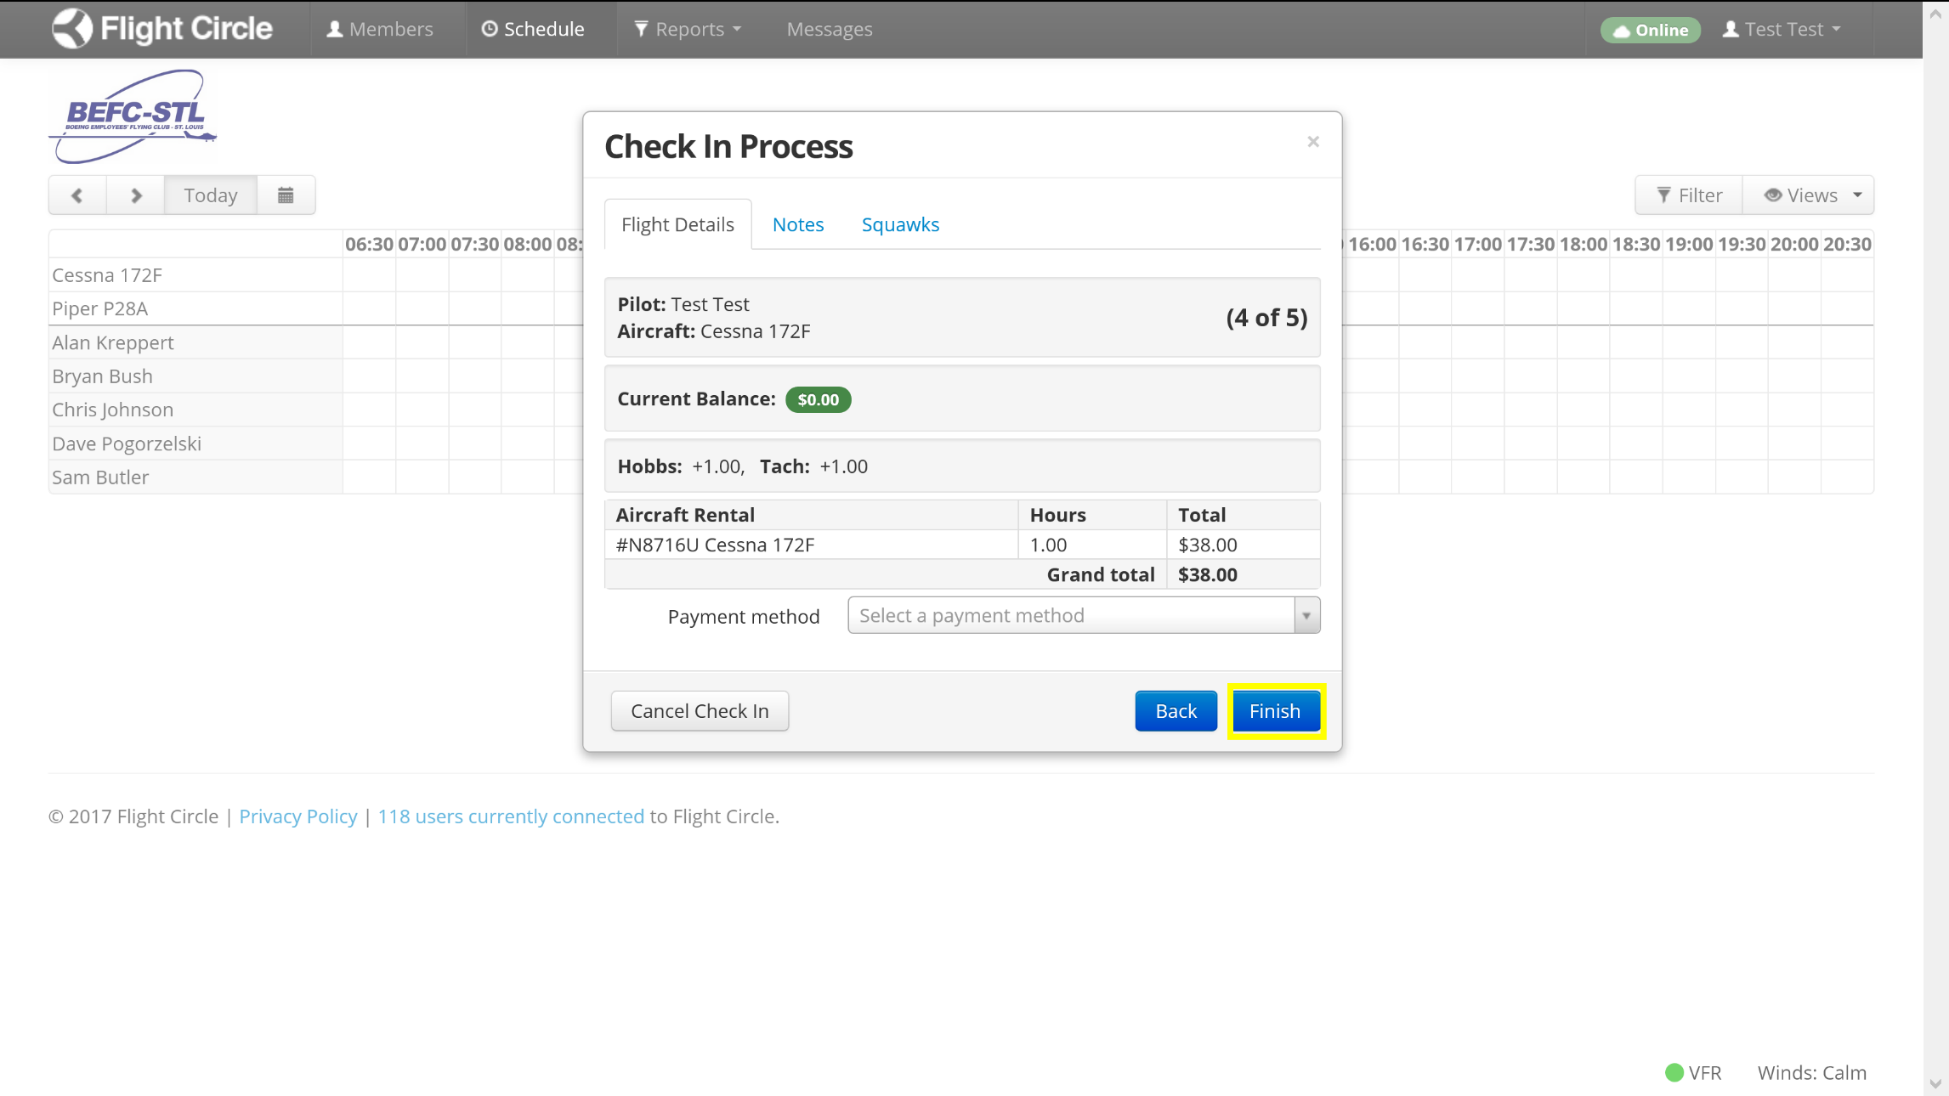
Check-in a flight – Step 5

Slide 13
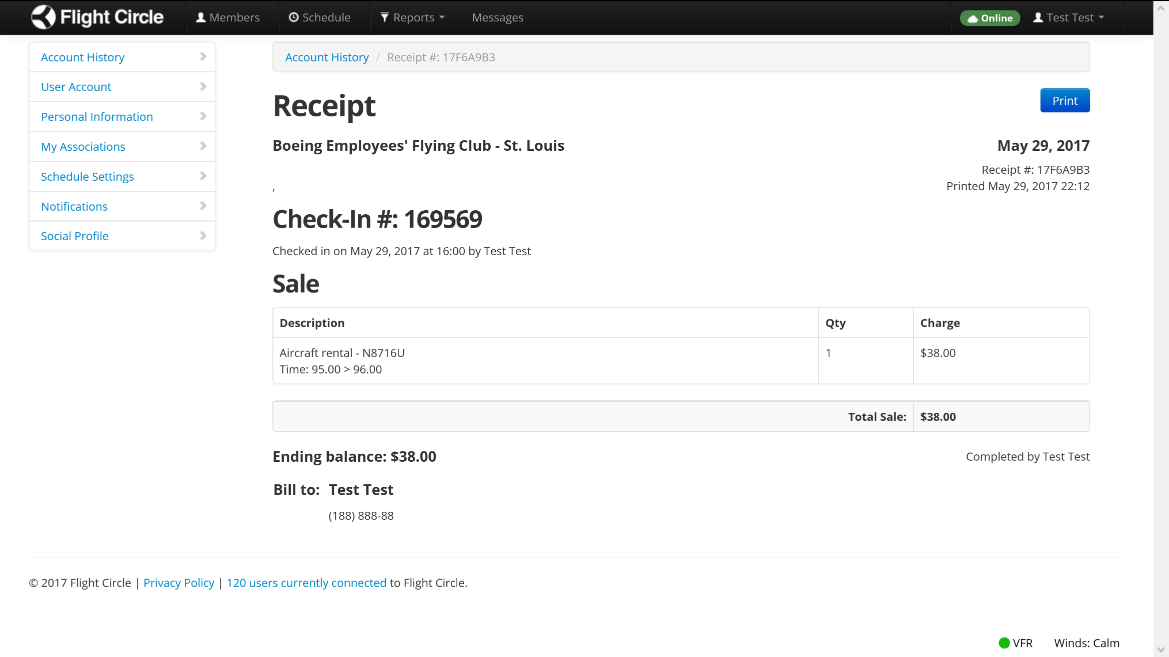
Check-in a flight – Step 6 (View Receipt)

Slide 14
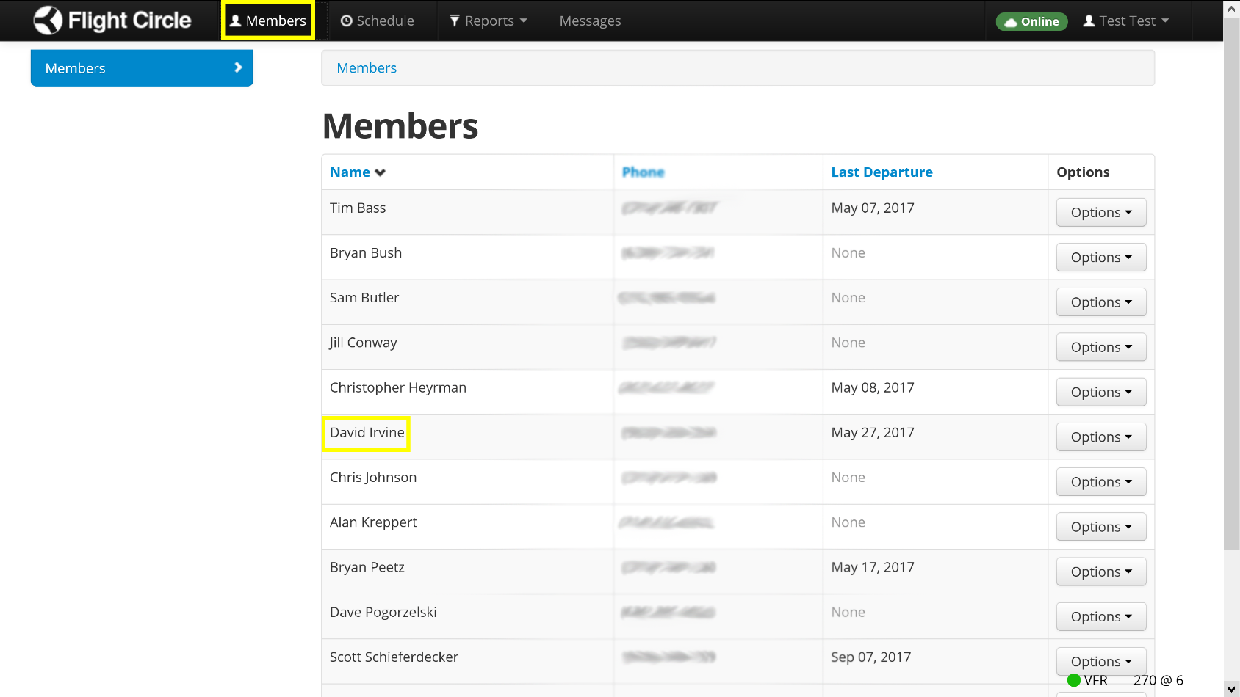
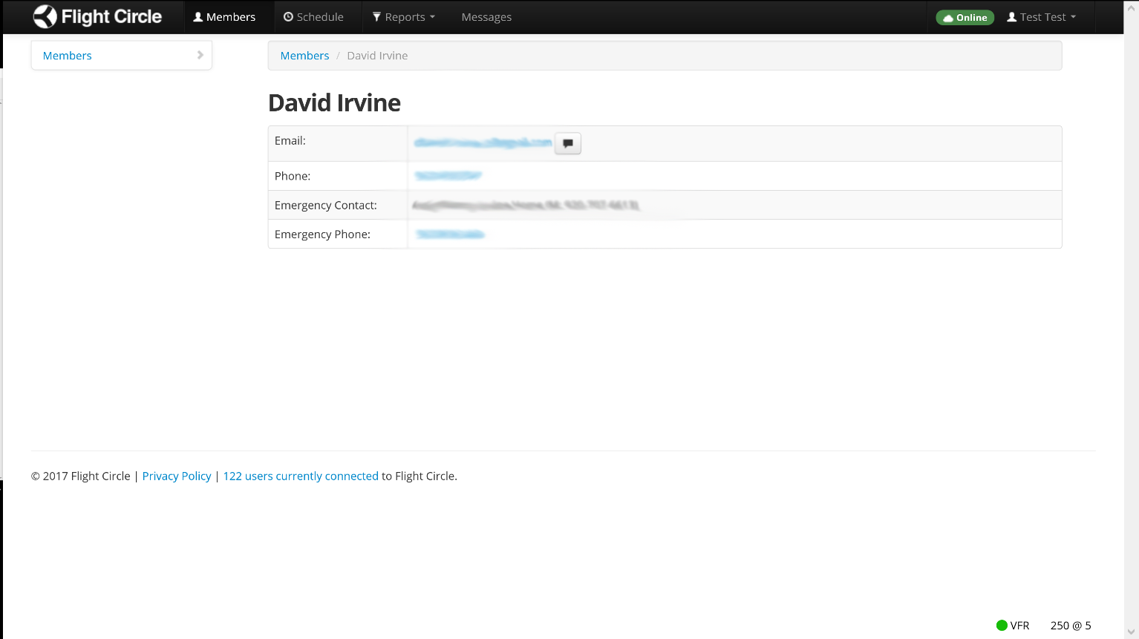
View Members Contact Info

Slide 15
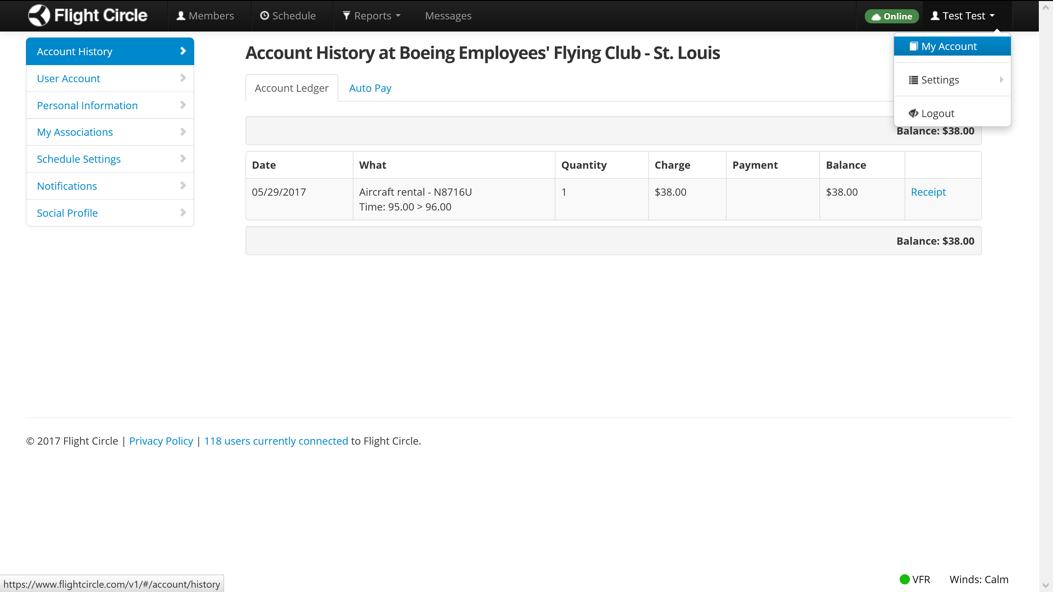
View Account Ledger

