Slide 1
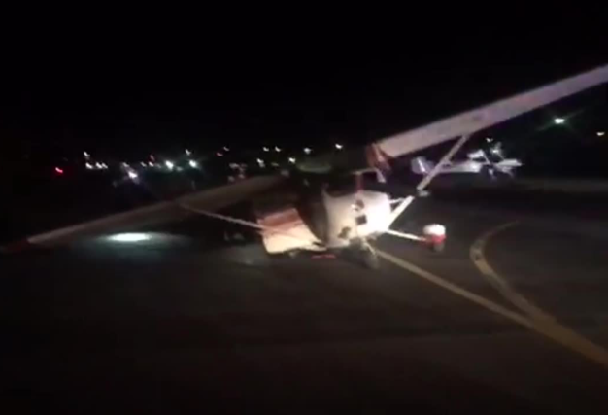

Airport Operations
(Avoiding issues on the ground)
Boeing Employees’ Flying Club
Check for people or aircraft directly behind
you before startup and taxi
Announce taxi intentions on the CTAF
Keep taxi speeds at a brisk walk or slower
  Reduce power so you are not riding the brakes the whole time
Watch for vehicles especially by the FBO where people don’t always stop at the stop sign
Use extra care when taxing near cars parked close to the taxi way
Be mindful of aircraft behind you during run up
  Don’t park behind an aircraft performing a run up

