Slide 1
Operations Briefing
www.befcstl.org
Rev 2022

Slide 2
This Briefing Covers:
Welcome & Club Introduction
Airport Overview
BEFC Aircraft ConOps
Safety & Passenger Safety
Hangar Access - Doors / Locks / Operations
Hanger Box - Lock/ Logs/Supplies
Aircraft Movement / Placement
Workbench/Cabinets & Supt. Equipment / Tools
Pre Flight / Departing / Post Flight
Winter Ops
BEFC Opportunities
DOOR KEY CODE: _________
HANGAR BOX CODE: _________

Slide 3
BEFC Club Introduction
Welcome to Creve Coeur Airport (1H0) and the BEFC hangar (#P-6).
We have 2 aircraft.
N8716U – 1965 C172F Cessna Skyhawk
Student Pilot Training Aircraft & Cross Country
N63PL - 1978 PA-28-161 Piper Cherokee Warrior II
Cross Country & Adv Training – IFR, Private Pilot or better.
We lease 3 spaces in the hangar from the airport
We have workbenches, parts, supplies, tools, & various equipment

Slide 4
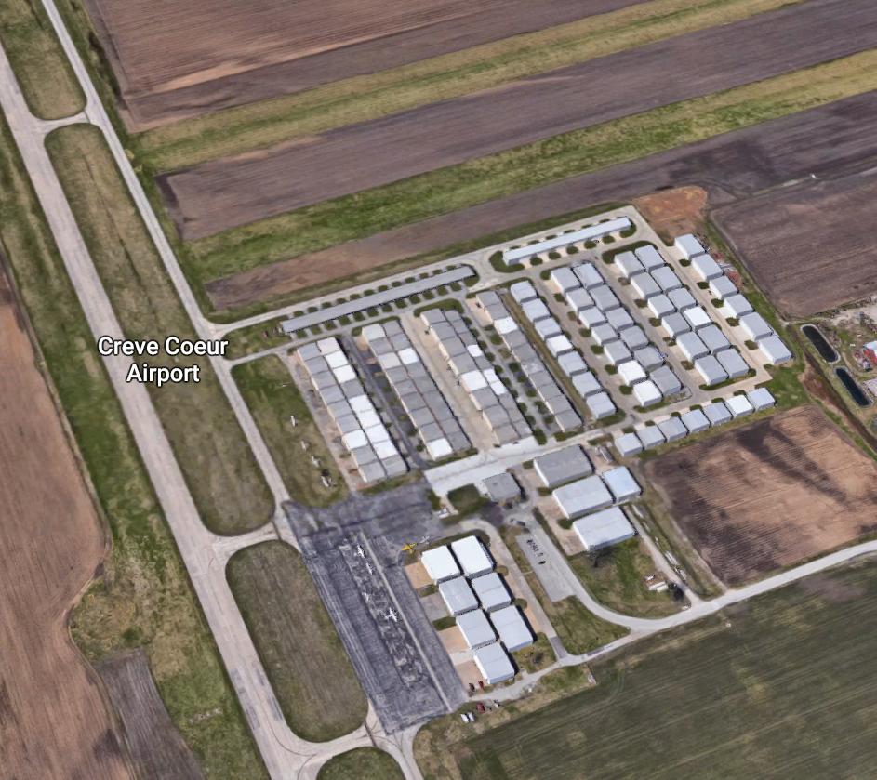
Airport Overview Creve Coeur Airport (1H0)
Grass strips
07-25 is grass runway on map
16-34 grass is along side paved runway
(this is unofficial but many tail draggers use this so you have to be vigilant)
BEFC in
Corner hangar P-6
Has a Boeing logo magnet on door
07 – 25 grass
Park in grass next to Hangar
16-34 grass
P
Driving in:
Use caution and go slow when on taxiway
16 - 34
Fuel Pump on Ramp
Line Crew or Self
Service after hours
Ramp
Airport Office
& Meeting Hangar

Slide 5
BEFC – ConOps
We treat each aircraft as if its our own (because it is).
BEFC aircraft are owner maintained where possible to help keep our operating costs down.
We have A&Ps in the club that assist with this. Many maintenance items require external A&P and FAA Airframe Inspector actions and we fully employ these professionals when needed. (we are cost conscious, but not cheap or undsafe)
As a member of a club you help & participate. There is a benefit to this as you will learn much more about the aircraft systems and their operation.
Examples:
Assist during routine maintenance tasks such as oil changes, landing / nav light changes, tire changes, brake pads
The annual inspection needs many hands to help remove cover plates / seats / brakes, clean / wax, …etc,
Periodic Plane washing, Hanger cleanup … and other

Slide 6
BEFC – ConOps - SAFETY
Safety & Safe Operations depend on all members
There is no line crew servicing the aircraft pre/post flight.
The eyes and ears for aircraft safety & maintenance are our members.
We do as much as possible to ensure a safe and airworthy fleet. But it is essential that we all work as a team and communicate.
We are responsible to each other for the airworthiness, cleanliness, and operation of the planes. This includes the Pre/Post flight actions, overnight/away operations, and following the reporting process for any issue(s), squawk, or aircraft grounding item.
Safety requires we follow the club By-Laws and Operating Rules.
FAR 91.3 Responsibility and authority of the pilot in command.
(a) The pilot in command of an aircraft is directly responsible for, and is the final authority as to, the operation of that aircraft.
Use of club aircraft does not alter this rule. Complying with required maintenance, preflight, or AD/inspection item is still the PIC responsibility.

Slide 7
Hagar & Flight Safety
Best Practices & Lessons Learned
Aircraft ground handling & movement safety.
Hangar Rash - Damage and/or collisions during ground handling
Push/pull hazards; tow bar use, turn limits, stowage
Don’t move propellers until you verified ignition off. Even then do it the right way. Never arbitrarily move any aircraft’s prop. Show how to correctly rotate/move a propeller.
Hangar Doors
Doors can interfere with each other, can hit cars/aircraft, could even get stuck
Aircraft Fuel & Fueling
Follow proper refueling procedures: grounding, checking caps, checking for water & contaminates. We don’t offload.
Startup – Area Clear -> towbar, ground wire, obstacles/debris
Towbars must not be on aircraft when plane is outside hangar & not actively maneuvering the plane. Never walk away & leave a towbar attached
Startup: What / who is in front of or behind you? What will you blast?
Taxiways – Watch for both Taxiing Aircraft & Cars on taxiways
Chemicals / Tools / Support Equipment
Distractions Cause Accidents

Slide 8
Passenger Safety
Give your passengers a mini hangar safety briefing too
Passengers want to be helpful – you MUST NOT let them attempt to do things they are not qualified for.
Remind/Tell any passenger who is helping you exactly what you want them to do/watch for. Don’t assume they know what a statement like “watch the wing” means. You are the one responsible for their actions.
Passengers should never touch/move a propeller.
The Fairchild is a fabric aircraft. (passengers & kids get curious – no poking)
Where can or can’t you push / pull on a plane?
Step / NoStep, Cowling, Spinner, Controls / Surfaces, Spars, …etc Make sure you really know because your passenger certainly doesn’t.

Slide 9
Hanger Doors
Main Entry Door – Demonstrate Lock and give combination
Best Practice: Close door behind you after entry & before operating big door.
Explain/show that it is possible for the entry door to collide/impact the hanger door while it is cycling
Leaving / securing hangar – checklist on the Door
Lights and Ceiling fans off
Rear entry door –closed & bolted ….ETC
Hanger Door – Operate / Demonstrate
NEVER MOVE AN AIRCRAFT IF THE DOOR IS NOT FULLY UP!
Point out the way the door operates and that it swings outward 10 feet when opening. Don’t park in front of the door. (notice 1H0 hangar doors w/ dents)
Show the UP/ DOWN / STOP control buttons
Explain the pulley system and the access panels next to the door.
Attend the switch when door is operating
If you ever think the door is malfunctioning or jamming – STOP DOOR and get the airport manager involved. If it gets jammed or broke it could take a month to fix.
Show the manual operation chain for the hanger door

Slide 10
Hanger Box
No longer locked
Cleaning Supplies (sprays, towels, rags, window/lexan sheets)
WINDOWS - ONLY USE special window cleaner and the special white windscreen wipes
Paper towels for checking oil, wiping struts
Simple green and Rags are for cleaning the aircraft surfaces (bugs, oil)
Other cleaners solvents for their designated purpose only (ex. Instrument cleaner, or degreaser for floor)
Tire Pump(s) – Tire Gauges
Oil - extra quarts & partials
RED Do Not Fly – A/C grounding sign – Place visibly in window
Restocking / something out? Its not someone else’s problem.
– tell someone, refill / mix as needed don’t just leave it – fix or ask

Slide 11
Dispatch / Check-In
Key box on the wall
Keys to Aircraft, Storage Cabinets, Tools
There are no paper logs/documents
WHITE BOARDS have inspections and due dates
Dispatch your aircraft/flight using FlightCircle.Com
‘SELF DISPATCH’ your flight before taking off
‘CHECK IN’ your flight when done
Enter times, Fuel used, Oil used, and SQUAWKS
AIRWORTHY? Y/N
YES - YOU CAN (and should) GROUND THE AIRPLANE
Put red sign in window, Call the next person, Post on FlightCircle

Slide 12
Aircraft Movement / Placement
The club has the planes are arranged in a specific way. Please do not change the arrangement.
When moving a plane, The best advice is go slow and be very careful.
The lines on the floor are guidance… but not an assurance of clearance. You must verify your movements.
When you maneuver via the towbar, the tail will swing much farther than the nose. If you turn and move the nose a foot sideways, the tail can swing 5 feet or more.
We have had cases of damage while moving planes in the hangar! Do Not assume that because others (even a CFI) are around nothing can happen.
Always assume moving a plane could hit something or another plane. DON’T TAKE A CHANCE do it right. Don’t Hurry--- hurrying = mistakes.
Towbars are provided to move & guide the planes.
Piper & Cessna use different towbars.
The Towbar is NEVER left attached to plane outside the hangar if your hand isn’t on it.
WARNING – Aircraft are TURN RADIUS LIMITED, over steering past the turn limit can damage the steering linkage. Read the POH
Even Minor Damage can Cost Thousands to Repair

Slide 13
Tow Bar Procedures
Tow bar practices:
tow bar never leaves hand when not in baggage compartment
leave baggage door open while tow bar is out
visible reminder to place tow bar back in baggage area
tough to get back into piper when baggage door open
walk-around airplane ever time prior to getting in
use the checklist with purpose and truly think about where the tow bar is located
Be especially cautious if/when moving both aircraft and having to alternate between them. Forgetting to remove on the last one moved has happened.
Proper Procedure to pull out Piper (if when in a confige where its behind Cessna….Now that we have 3 hangar spots this is not the norm)
1) remove tow bar from Cessna; leave baggage door open 2) pull Cessna out of hangar 3) remove and replace tow bar in Cessna baggage area 4) remove tow bar from piper; leave baggage door open 5) pull piper out of hangar 6) remove and replace tow bar in piper baggage area 7) remove tow bar from Cessna; leave baggage door open 8) push Cessna back into hangar 9) remove and replace tow bar back In baggage area 10) close the Cessna baggage door 11) walk around piper to look for any abnormalities 12) visually check on tow bar in piper baggage 13) close the baggage door and enter cabin

Slide 14
shelves
Cabinets
Tail near cabinets
Workbench - Tools
Wing near hanger support beam?
Or ladder or tool boxes?
Fairchild – Tail Dragger
Cessna 172
Cherokee
Will anything hit the box? Did lid get left open?
Any ladder here?
Box
Any wing/strut interference? 172 stabilizer and Cherokee. Is Cherokee prop horizontal?
Fairchild and 3PL tail
Prop/spinner and hangar door
= Hot Spots
NOT TO SCALE

Slide 15
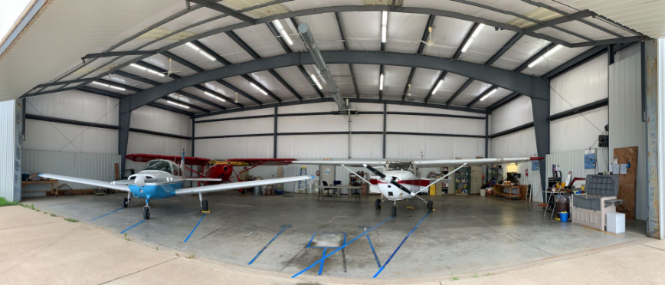

Slide 16
BEFC Cabinets / Supplies Support Equipment / Tools
Workbenches & supply cabinets
Location of keys for supply cabinet and the tool box
Tools & Specialty Tools
maintaining a/c, changing oil, air filter, tires, plugs, engine tuning
Ladder
Chemicals / cleaners
Water
Oil / filters / other cabinets
Refrigerator
Support Equipment
Tie down anchor kit
Tie down ropes
Cowling plugs
A/C Covers
Tow bars / Tug
63PL Ground Power inverter
Spare Parts
Maintenance & Aircraft Logs

Slide 17
Pre Flight
Show each aircraft / Walk around + Specific aircraft checks/things to know.
Doors, POH & Manuals, W&B, airworthiness certificates
Open engine cowling – 3PL cooler, key, sump
Oil levels, don’t overfill, Don’t over tighten dipstick – demonstrate. 3PL standpipe, 16U cap,
Always check tires & air pressure, brakes
Fuel testing / Fuel drains
Fuel quantity and quality
Don’t dump fuel in the hangar
Show tow bars, and move an aircraft

Slide 18
Preflight
Reminders:
Your preflight should not assume anything.
Solo or Dual you have to ensure the airworthiness
Have an mindset that you may not go fly today
Be suspicious/cautious – Where is the problem? What are clues?
If you find equipment left in the plan call the prior member. (lost&found on back wall desk)
Cherokee fills to tabs (17 gal tabs, 34 total)
You can fill higher if you need. We don’t offload fuel though.
Can Preflight in the hangar or outside
Not Sure, need something? Call and ask

Slide 19
Departing
VERIFY TOW BAR REMOVED BEFORE BOARDING THE PLANE & ENGINE START.
ALWAYS walk around the plane 1 more time before you board.
Close the hangar behind you when departing
We don’t leave the hangar open even for short flights. (assumes someone else is not in the hangar)
Move/Line up on the taxiway
Be aware of what’s behind you before you start the engine (this is true no matter where you are)
Discuss Taxiing at 1H0
Remind about the Grass Runway(s) & Traffic Patterns

Slide 20
Post flight
Re-fuel the aircraft tanks as specified in the Operating Rules
Explain the self-serv process @ 1H0 – grounding clip, filling, cost diff
Secure inside plane
Remove all your items/maps/headsets…etc., clean up interior
Secure seat belts and shoulder harnesses
Remove keys, ignition/switches off
Clean the aircraft - Leave it like you would want to find it.
Clean windows ONLY WITH the proper window cleaner & sheets.
Wipe down the painted surfaces and clean the bugs off
Simple Green and Rags, Refill/Make more if needed
Leave dirty rags out to dry, we wash or pitch.
CHECK IN on Flight Circle.
Notify others if problems found. (phone, email - FlightCircle, Squawk)
Return keys to log box
Secure the Hangar – checklist on door
Turn off fans, lights, lock all cabinets / tool boxes…etc

Slide 21
Cold Weather Operations
Both aircraft have electric engine warmers/heaters
Both aircraft have supplemental oil coolers
At some point in the fall temperatures dictate rigging for cold weather
Aircraft oil warmers get plugged in – part of your pre/post flight
There is a cover plate that blocks the air flow to the oil cooler
(show the plate location on the a/c and how it attaches)
There are operating thresholds for the cover plate.
50 Degrees. If it is a warm day, It is very possible you may have to remove the plate due the temperature at the time of your flight (Cherokee only).
In very cold periods we also cover w/blanket and insert cowl plugs.
No flights when surface temp < 10º F
BEFC Operating Rules exist for hangaring & engine pre-heat when operating away from 1H0. Please become familiar with them as a cold start is not allowed.

Slide 22
BEFC Miscellaneous
We use Flightcircle.Com for scheduling
FC also has Reports for
Squawks, Inspection & maintenance due times
Get Flightcircle.com working on you smart phone browser too
Website – www.befcstl.org …
A/C manuals and docs – on web site
Club Contacts
Creve Coeur Airport numbers:
314-878-6400 314-878-9575

Slide 23
BEFC Opportunities
Plane / Hangar Captain
Check on oil & other club supplies
General Condition / Appearance of A/C, & Equip
Membership & Publicity
Committee(s) / Club growth
Trip / airport reports, $100 hamburger, newsletter
Member meeting presentation
Report Accomplishments
Website help/growth, other IT help
Finance Treasurer assistant
Fleet Maintenance Participation
You are a better pilot if you see/understand the systems you use and depend on

